Slide 1
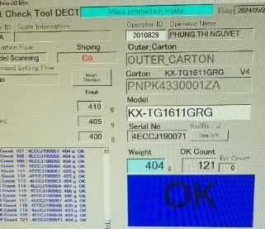
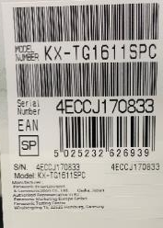

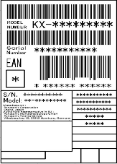


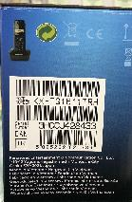

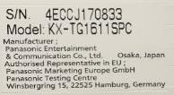



ADD MORE ITEMS SCAN SERIAL OF BASE & REMOTE ON WEIGHT
Line/Team : DECT
PIC: Phan Thi Duoc Lieu
Expn: 0 USD
Issue date : Nov.2023
Apply date : Pending
♦ Before
♦ After
Stick serial no label in
Base & remote.
FCT
Assemble
Auto Inspection
Auto
Shipping
PL check
Fold box
Packing
FCT
Assemble
Auto Inspection
Auto
Shipping
PL check
Fold box
Packing
Compare serial carton with Base & remote
by manual. Because the serial no have barcode
Stick serial label in
Base & remote.
Compare serial no carton with Base & remote
by scan barcode
Scan barcode in Weight
KX-TGC1611SPC
4ECCJ170833
Add barcode remote
Request IT add more
items scan serial Base
& remote on weight
Serial
carton
has barcode
Serial Base
No barcode
Serial remote
no barcode
Add QR Base
Before:
After:
Check compare serial by manual
=> Lost time : 3s/1pcs ~60min/day
May be mixing serial no on production
Add more items scan serial of base & handset on weight
Reduce time : 20min/day ~ 5,760min/year
-> Save : 132USD/year
=> Ensure quality ( Prevent mixing serial )
Notes:
PART BODY WIP using for 18L Model need 6 process include 5 process using press machine & process number 5 using bending machine but THANHCONG don’t have bending machine so need to order outside bending maker & back to THANHCONG and complete process number 6
-> take time to movement and high cost, difficult control
After study design bending tooling can use in press machine to replace using bending machine

